Slide 1

Information Systems in Global Business Today.

Slide 2





Team Members
2018-42
Md. Fakhrul Ambia Chowdhury
2018-50
Sumona Bhowmik Sristy
2018-53
Mitu Chakroborty
2018-85
Mahraj Hussain Shohag
2018-91
Safika Shahrin Haque

Slide 3

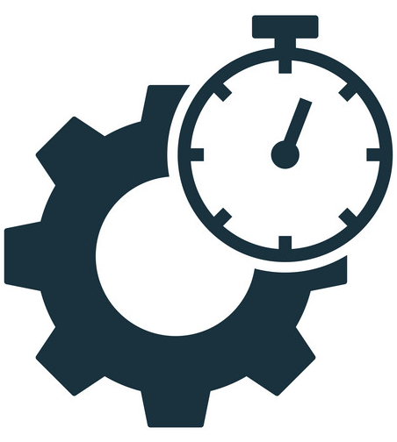

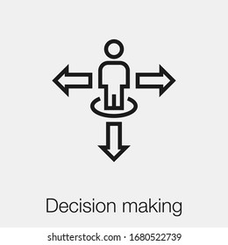
The Role of Information Systems In Business Today
How Information System Transforming Business
Efficient Functioning
Behavioral Changes
Better Decision Making

Slide 4

Strategic Business Objectives of Information Systems.
1
Operational Excellence
2
New Products Services & Business Model
3
Customer & Supplier Intimacy
4
5
Competitive Advantage
6
Survival
Improved Decision Making

Slide 5
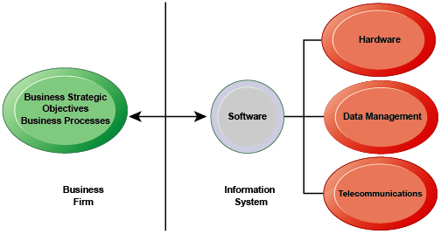
The Interdependence Between Organizations & Information Systems.

Slide 6

Perspectives On Information Systems
Information System
A set of interrelated components that;
Collect
Process
Store
Distribute Information

Slide 7
Data and Information
Data
Information
Raw facts & numeral figures.
Processed, Organized & Structured Data with meaningful representation.
Information System
101 Sylhet
Rafiq A+
Roll | Name | District | Result
101 | Rafiq | Sylhet | A+

Slide 8
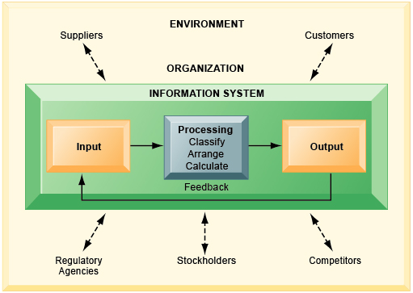
Functions of An Information System

Slide 9
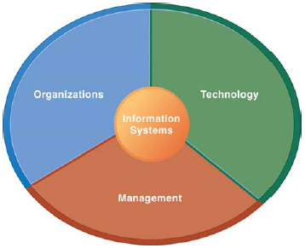
Dimensions of Information Systems
Broader Dimensions of Information Systems

Slide 10
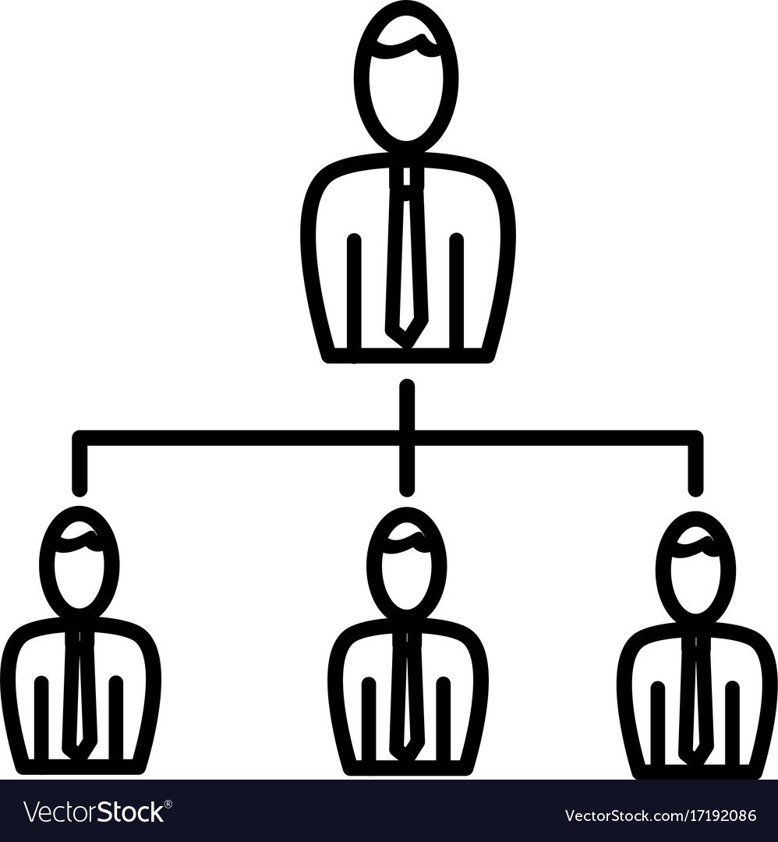


Dimensions of Information Systems. (CONT)
Organizations
Management
Information Technology

Slide 11

Levels In A Firm
Senior Management
Middle
Management
Operational
Management

Slide 12
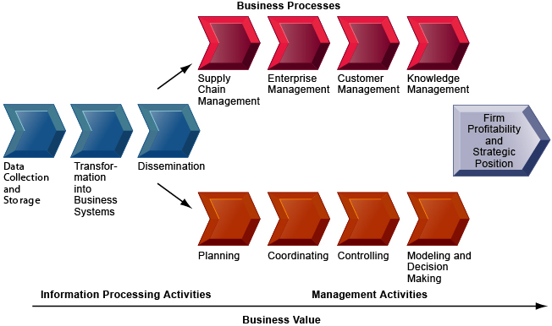
The Business Information Value Chain

Slide 13

Complementary Assets to Optimize Returns From IT Investment.
Supportive Organizational culture
Efficient Business Process
Managerial
Assets
Strong IS Development Team

Slide 14

Complementary Assets to Optimize Returns From IT Investment. (Cont.)
Strong Senior Management
Collaborative Work Environment
Organizational
Assets
Training Programs for Enhance Skills.

Slide 15

Complementary Assets to Optimize Returns From IT Investment. (Cont.)
Telecommunication Infrastructure
IT Enriched Education Programs
Social
Assets
Maintaining Standards

Slide 16
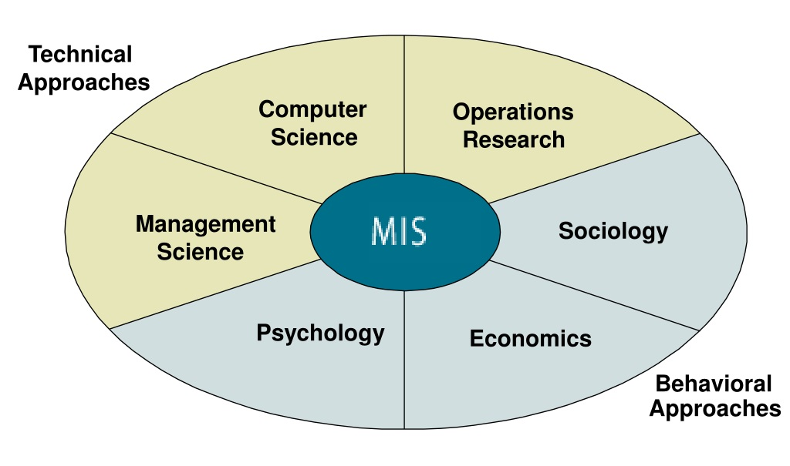
Contemporary Approaches To Information Systems.

Slide 17
Contemporary Approaches To Information Systems. (CONT.)
Technical Approaches
Behavioral Approaches
Mathematical based models to study information systems.
It concentrates on changes in organizational policy.
Contributes in Computer science management & operations research.
It can explore useful business integration.

Slide 18

Sociotechnical Systems
Optimal organizational performance is achieved.
Technology must be changed to fit organizational and individual needs.

Slide 19
Thank You!

